Slide 1
Contact Lens use in cambodia
A Presentation by
Dr. Woody Thigpen, Optometrist

Slide 2
Contact lens use in cambodia Dr. Woody Thigpen, optometrist
Doctor of Optometry since 1978
UAB – School of Optometry – Birmingham, AL
Licensed in State of Virginia
Continuing Education
Doctors of Optometry in the United States
4 years beyond Bachelors Degree
Notes:
Tell personal story – who you are.
Tell what a Doctor of Optometry is and what they can do in the US. Some OD can us diagnostic drugs and some can treat eye disease
15 years in Cambodia – PP, Kampong Cham and Siem Reap.

Slide 3
Contact lens use in cambodia
Notes:
I have been a Doctor of Optometry now for over 36 years and as I think about the human eye, I cannot help but be amazed with its over 2 million parts. I marvel at the human eye and the God who not only created the heavens and the earth but also created you and me and gave us not just physical vision also spiritual vision so we could know Him personally. Please speak with me if you would like to know more about the God above all gods.

Slide 4
Contact lens use in cambodia
Potential Problems
Notes:
The first thing you needed to be reminded of when talking about contact lens use in Cambodia are the potential problems from wearing contact lenses.
I see many contact lenses sold in Asia without being fitted by a healthcare professional. This is contrary to standard practice and very dangerous.

Slide 5
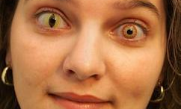
Contact lens use in cambodia
Cosmetic CL
Notes:
People can purchase contact lenses for changing the color of their eyes without a prescription. I have seen boxes for sale on the street and through various vendors throughout Asia.
This is an extremely dangerous practice. People do not know the harm that can be caused by this use of contact lenses for cosmetic purposes. They can lose their eyesight!

Slide 6
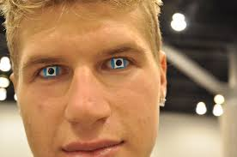
Contact lens use in cambodia
Cosmetic CL

Slide 7
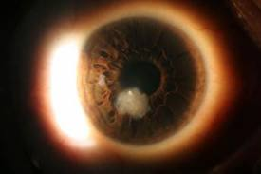
Contact lens use in cambodia
Corneal Ulcers
Notes:
So, as ophthalmologists what might you see as a result of these cosmetic practices and misuses and just as a part of seeing patients who wear contact lenses?

Slide 8
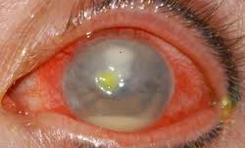
Contact lens use in cambodia
Fusarium Keratitis
Notes:
“Investigators found poor lens hygiene to be a factor in 82% of the Fusarium cases reported in Singapore.” Castellano, Carmen.(2008). Current trends in daily disposable contact lenses, Optometric Management, 01/09/2008. Retrieved from http://www.optometricmanagement.com/articleviewer.aspx?articleID=102129

Slide 9
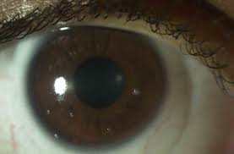
Contact lens use in cambodia
CL Deposits

Slide 10
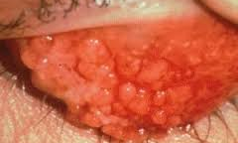
Contact lens use in cambodia
Giant Papillary Conjunctivitis

Slide 11
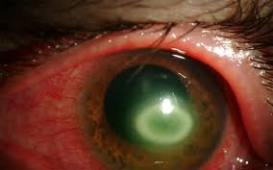
Contact lens use in cambodia
Acanthamoeba Keratitis
Notes:
Make sure patients know not to put the CLs in water or in their mouth. 60,000 bacteria per drop of saliva. Do not wash case out with tap water – only disinfectant. Wipe out with clean towel.

Slide 12
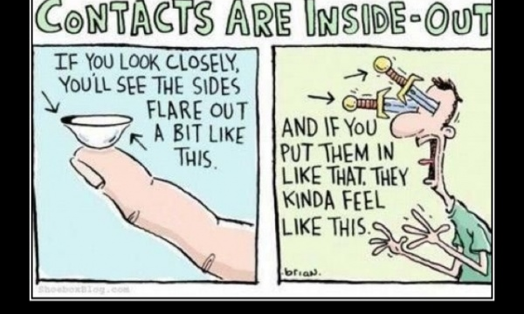
Contact lens use in cambodia
Orientation of a Soft CL
Notes:
This happens often with low power of flimsy lenses. If a patient reports loosing their lens be sure to look under their upper lid. I have found many a lost lens under the upper lid.

Slide 13
Contact lens use in cambodia
Up to 80% of contact lens complications trace back to the patient not following instructions – poor patient compliance.
Notes:
Castellano, Carmen.(2008). Current trends in daily disposable contact lenses, Optometric Management, 01/09/2008. Retrieved from http://www.optometricmanagement.com/articleviewer.aspx?articleID=102129

Slide 14
Contact lens use in cambodia
Some research concludes that certain care products are problematic when applied to certain lens materials.
Wrong combinations can create huge problems.
Notes:
Castellano, Carmen.(2008). Current trends in daily disposable contact lenses, Optometric Management, 01/09/2008. Retrieved from http://www.optometricmanagement.com/articleviewer.aspx?articleID=102129

Slide 15
Contact lens use in cambodia
Sensitive patients may still develop allergic or toxic reactions.
Notes:
Castellano, Carmen.(2008). Current trends in daily disposable contact lenses, Optometric Management, 01/09/2008. Retrieved from http://www.optometricmanagement.com/articleviewer.aspx?articleID=102129

Slide 16
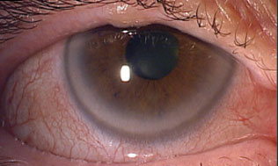
Contact lens use in cambodia
CL Solution Hypersensitivity
Notes:
In my early days of Soft CL fitting (1980’s) there was a terrible problem with delayed allergic reactions to a preservative in the CL solution – Thimerosal. It is a mercury containing compound. So beware of this preservative.

Slide 17
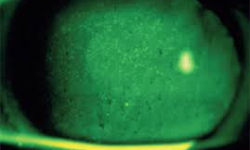
Contact lens use in cambodia
CL Solution Hypersensitivity
Notes:
Other challenges can result from Tight Lens Syndrome and Corneal Warpage when using Rigid Gas Permeable - RGP lenses.

Slide 18
Contact lens use
Latest Trends & Research
Notes:
What are the latest trends and research surrounding contact lenses worldwide?

Slide 19
Contact lens use in cambodia
Antimicrobial CL
Reduce eye infections
- Peptide called melimine
Notes:
Australian researchers are working on an Antimicrobial CL –a coating using melimine.

Slide 20
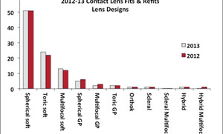
Contact lens use in cambodia
2012 -13 Lens Design
Notes:
There are 37 Million CL wearers in USA. 76% are using chemical based disinfectant – 24% use hydrogen peroxide based solution.
6 to 7 x more O2 passed with Silicone Hydrogel lenses than Hydrogel lenses. Increased O2 permability means the cornea can breathe better, reduces corneal stress. There is a connection between infection and lack of O2 to the cornea. Silicone Hydrogel - the lens of choice - 66% are fitted with SiHy / 24% fitted with Hydrogels / 8% GP

Slide 21
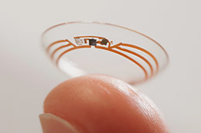
New Smart CL
Google and Alcon – CL with embedded sensors – measures glucose levels
info transmitted to wireless device

Slide 22
Contact lens use in cambodia Dr. Woody Thigpen, optometrist
Recommendations for Cambodia:
Due to compliance issues and issues with hygiene,
I would advise the use of daily wear disposable CL or a daily wear schedule with a high water content CL.

Slide 23
Contact lens use in cambodia Dr. Woody Thigpen, optometrist
Presented on behalf of
Cooperative Services International (CSI),
Serving Cambodian people since 1984.
Thank You
E-mail
wlthigpen@mailcentral.biz
Notes:
Thank you for allowing me the privilege of addressing you today. I volunteer for the NGO CSI (Cooperative Services International). If you have questions or would like to know more, please contact me.

